Slide 1

Medtech marketing plan template
This template provided by Definitive Healthcare is intended to support your annual marketing planning efforts. With examples of core marketing plan components, this template provides a framework for alignment and understanding, as well as communicating key initiatives, programs, and messages.

Slide 2
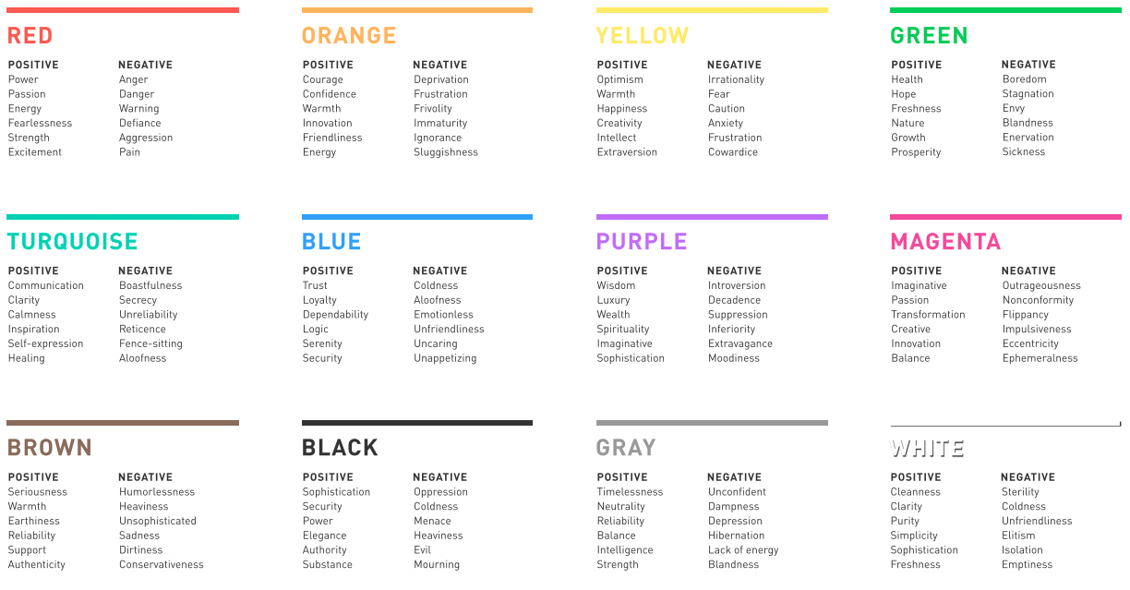
Color Psychology – create your slideware color scheme
Always use an on-brand slide deck issued by your corporate marketing or marketing communications team.
If you don’t have one, consider color psychology. It’s a powerful tool in branding, marketing, and design in general. This chart provides a quick glimpse at the psychology behind 12 of the world’s most popular colors. While context and culture matter, research has shown that these are the emotions most often associated with each color.
Whichever medium you’re working in, this quick reference guide will help you pick the color that best communicates the meaning behind your design.
2

Slide 3
[Year] [Portfolio name]
Marketing plan
Your name

Slide 4
Table of contents
Business goals and priorities summary:
  Describe the market
  Business goals
  Priority initiatives
Market understanding:
The market
  Situational analysis – market trends
  Opportunities and challenges
  Influencer map
Marketing Programs:
  Marketing budget request summary
  Marketing programs and high-level execution
Customer Understanding:
The customer
  Segmentation and targeting
  Buying process
  Understanding personas
The competition
  Identify key competitors
  Competitor profile
The product:
  Product definition
  Benefits ladder
  Product / Personas / Messages alignment
  Competitive performance assessment
Pricing:
  Guiding principles
  Current pricing structure
  Rebate and/or reimbursement structure
  Goals and recommendations
“IWIK”
  I wish I knew gap and plan
4

Slide 5
Macro external themes
Identify several external and internal concepts to help give purpose to your proposal.
Top macro external theme / trend
Image or icon
placeholder
2nd macro external theme / trend
Image or icon
placeholder
3rd macro external theme / trend
5

Slide 6
Macro internal themes
Identify several external and internal concepts to help give purpose to your proposal.
Image or icon
placeholder
Top macro internal theme / trend
Image or icon
placeholder
2nd macro internal theme / trend
Image or icon
placeholder
3rd macro internal theme / trend
6

Slide 7
Business goals and priorities

Slide 8
Total market overview
Use this slide to populate relevant details of your total market overview, including your company performance.
Overview of what the market encompasses
Your market definition
Your product types
Your ideal patient population
Your treatment or diagnosis landscape
Competitors and new market entrants
Market share by competitor
Your prior FY results (if available)
Actuals (chart)
AOP/LRP comparison (chart)
8

Slide 9
Portfolio overview
Insert your own breakdowns of your current portfolio.
Which products/ product lines are selling the most versus least? What’s impactful for your business, units, dollars?
Product line B
Product line A
$XXM
22%
Product line E
[Details as needed]
[Details as needed]
$XXM
4%
[Your portfolio]
Est. overall MS%: XX%
Product line A: 51%
Product line B: 22%
Product line C: 19%
Product line D: 5%
Product line E: 4%
$XXM
5%
$XXM
51%
Product line D
$XXM
19%
Product line C
[Details as needed]
9

Slide 10
Market overview
Use this slide to highlight additional details – breakout of your top selling products within portfolio – and more.
Additional details about competitors, new innovations, market size, CAGR projections, national procedure volumes, patient population information, or anything else relevant. (Definitive Healthcare can provide intelligence to help you overview your target market).
Product line specific FY results
Actuals:
Insert pie charts, other graphs or data points as relevant.
10

Slide 11




Business goals — Region (if applicable)
List out your company or portfolio specific objectives and KPIs.
oBJECTIVE AND KPIs
FINANCIAL
Achieve
Financial item(s)
$XXMM
STRATEGIC
Strategic item 1
Strategic item 2
Strategic item 3
MARKET
SHARE
Market share item(s) (E.g. grow market share by 4% for specific product)
BRAND
REPUTATION
Brand reputation item(s)
11

Slide 12
Situational analysis — External trends
This should be a broadly encompassing, detailed list or high-level analysis of external trends in
your market.
You should indicate headwinds versus tailwinds, the potential impact, and priority level.
Headwind/ tailwind | Factor / Trend | DESCRIPTION | POTENTIAL IMPACT to [Your Company]
Tailwind
Headwind
Headwind
12

Slide 13
Situational analysis — Internal trends
This should be a broadly encompassing, detailed list or high-level analysis of internal trends in
your market.
You should indicate headwinds versus tailwinds, the potential impact, and priority level.
Headwind/ tailwind | Factor / Trend | DESCRIPTION | POTENTIAL IMPACT to [Your Company]
Tailwind
Headwind
Headwind
13

Slide 14
Business goals — Region (if applicable)
Place your identified headwinds and tailwinds into the corresponding section of this table for an easy-to-view summary.
internal
External
Specific internal tailwind
Specific internal headwind
Specific external tailwind
Specific external headwind
Higher Importance / Impact
Specific external tailwind
Specific external headwind
Specific external tailwind
Specific external headwind
Lower Importance / Impact
14

Slide 15
Influencer map — [Product / Product A] (example)
Influencer maps can be messy, so play around with your formatting to find the right layout. This should include all areas of influence that may impact the buying process.
Think through specific surgical departments, physician groups, personas, GPOs, KOLs, patient impact, government and regulatory agencies, your organization, and your competitors as the manufacturers. Your connecting lines should tie together each area of influence. In the provided examples, there are reciprocating influence lines because the sample environment is connected and has mutual influences. You’ll also notice that ‘entities’ are presented in different shapes than individual influencers.
Examples are included in the following slides.

Slide 16
Influencer map — [Product / Product A] (example)
Key leverage point
Manufacturer
Circle size indicates extent of influence on purchasing decisions
Government
& Regulatory
Dashed lines show how the influence is either growing or shrinking in the future
FDA
3
1
Gastroenterology
Dietician
GPOs
Key opinion
leaders
2
Academics
Director of
Pharmacy
Patient
Societies

Slide 17
Influencer map — [Product / Product B] (example)
Key leverage point
Circle size indicates extent of influence on purchasing decisions
1
Manufacturer
Government & Regulatory
Dashed lines show how the influence is either growing or shrinking in the future
Director of
Pharmacy
FDA
CFO
Academics
2
Materials
Management
Key opinion leaders
Reference sites
Patient /
Community
Societies
3
Nursing
GPOs

Slide 18
Marketing programs

Slide 19
Marketing program (template details)
The below table displays examples with descriptions of marketing objectives for use in your program table
MARKETING OBJECTIVES | DESCRIPTION
Awareness | A time-bound, strategic campaign aimed at increasing visibility and awareness of your product, company, or brand
Lead generation | Strategic marketing efforts that aim to attract and capture potential decision-maker, influencer, or user interest in your product, ultimately generating valuable leads
Sales enablement | Content, coaching, training, and technology to help reps improve their skills and sell more efficiently; may include the creation of marketing materials for sales to utilize
Customer & market insights | Market research programs, voice-of-customer programs, surveys, etc.
Portfolio expansion | Upstream marketing efforts with the goal of exploring opportunities to expand product portfolio or indication
Conferences or summits | Industry- or company-focused events for the discussion of timely topics
Incentives | Product- / product line-specific SPIFF programs, if not budgeted through sales

Slide 20
Marketing program (template details — example tactics)
Academic journal: A scholarly publication containing articles and whitepapers written by researchers, professors, and other experts; typically peer-reviewed
ABM: Account-based marketing
Banner ads: Use of a rectangular graphic display that stretches across the top, bottom, or sides of a website or online media property; a paid form of advertising
Direct email: Email campaigns sent directly to a defined list of targets, usually to establish a relationship between the brand and the customer
Event/conference sponsorships: Paying a premium to support the efforts of an industry conference, usually in return for brand mentions, advertisements, or sponsored giveaways that are included in the fee
Geotargeting: A marketing strategy that targets ads based on physical locations
In-facility advertisements: Utilizing printed or digital materials within a physician’s office or hospital for educating patients on your treatment; can include brochures, branded educational posters, looped videos on a waiting room monitor, etc.
Industry society partnerships: Scientific collaboration with known industry societies intended to reach clinical, medical, or scientific buyers, users, or influencers in support of your organization, device, or product
Keyword optimization: The process of researching, analyzing, and selecting the best keywords to target for organic search traffic
KOL champions: People or organizations with considerable decision-making influence and well-respected reputations within an industry
Patient support programs/communities: Programs, communities, or advocacy groups that support patient access to care and assist patients with navigating through the complex healthcare system
Pay per click: A digital advertising model in which a company places an advertisement on a website and pays a sum of money to the host website when a user clicks on the ad
Print publications: Hard copy advertisements, whitepapers, journal articles, and other industry publications—anything involving words printed on physical media
Programmatic advertising: An automated process of placing ads using data about the users to decide which ads will be most effective
Public relations (PR): Professional maintenance of a favorable public image via strategic communication by or for an organization or public figure
Radio advertising: The promotion of products or services via radio or music streaming services; can include standard AM/FM radio stations as well as digital platforms like Spotify, Pandora, YouTube Music, iHeartRadio, etc.
Retargeting: A dynamic digital marketing strategy designed to engage potential customers who‘ve shown interest in your brand but haven’t converted
SEO strategy: The process of organizing a website’s content by topic and keyword to improve the likelihood of appearing in specific search results
Social media marketing: Using social media platforms to build a company’s brand, increase sales, and drive website traffic; can be utilized organically or through paid promotion
Symposiums: Events in which experts in a given field meet, present papers, and discuss issues and trends or make recommendations for a certain course of action
Third-party promotion: Utilizing a third-party organization for brand awareness or content promotion for a fee
TV/Streaming advertising: The promotion of products or services via commercials on television or video streaming services
Webinars: Online informational seminars hosted by organizations and broadcasted to a select group of individuals; also referred to as “webcasts,” “online events,” or “web seminars”
NOTE: Definitive Healthcare provides contact details for email marketing campaigns, as well as provides executive contacts, so you can identify who you want to target across varying tactics.

Slide 21
Marketing programs summary
Summarize key outcomes you are hoping to achieve as well as your total requested annual budget.

Slide 22
Marketing programs (add more slides as needed)
Strat obj | Mktng Obj | Marketing Tactic | Short Description | Timing | Measure of Success (KPI) | Est. costs ($)
Key strategic objective 1 (add more categories as needed) | Demand creation | Demand gen campaigns |  |  |  | $
 | Awareness | Awareness campaign |  |  |  | $
 | Sales enablement | Product collateral |  |  |  | $
 |  | Samples |  |  |  | $
 |  | Website |  |  |  | $
 |  | Inservicing materials | . |  |  | $
 | Conferences | Conference 1 |  |  |  | $
 |  | Conference 2 |  |  |  | $
 |  | Conference 3 |  |  |  | $
 | Incentives | SPIFF |  |  |  | $
The strategic objective column should align with your corporate leadership's or business unit leader's overarching business goals for the year. Your marketing programs and objectives should align with your corporate goals.
Add other objectives as you see fit, these are examples as you fill out the program template.

Slide 23
The customer

Slide 24
Segmentation structure example
Customize this
to your target
markets and
your segmentation criteria.
This is an example segmentation structure for hospitals and IDNs.
Definitive Healthcare intelligence can provide the details needed to develop your segmentation structure.
HOSPITALS / IDNS
Commitment to
existing portfolio
Competitive Accounts
All Member
Tier level
Tier level
Tier level
Tier level
GPO affiliation
Vizient
Premier
HPG
Ascension
Regional
IDN affiliation
IDN #1
IDN #2
IDN #3
IDN #4
IDN #5
Hospital type
Short term acute
Children’s
Specialty
VA
Account size
(e.g. census beds)
< 100 CB
101-200
201-300
301-400
401 - 500
501 >
Notes:
Works as a funnel
May start with what type of product portfolio does my ideal customer have
Competitive product? Complimentary product? Or a specific tier of complexity they should be familiar with?
Work down from there look at affiliations based on partnerships you have today and what type of hospital makes sense
Then take that total market and start tiering it out by things like size (in this example we're using census beds)
Nail down exactly what hospitals you'll be targeting with your device

Slide 25
Segmentation structure example
Customize this
to your target
markets and
your segmentation criteria.
This is an example segmentation structure for physicians.
Definitive Healthcare intelligence can provide the details needed to develop your segmentation structure.
PHYSICIANS
Physician specialty
Cardiology
Radiology
Pulmonology
Internal medicine
Obstetrics/ Gynecology
Family medicine
Affiliation type (e.g. physician groups)*
Southern California Permanente Medical Group
Mayo Clinic Physicians
Northwell Health Physician Partners
Ascension Medical Group
Independent
< 10
11-20
21-30
31-40
41 - 50
51 >
Referral volumes**
< 1000
1001-20k
20k-30k
30k-40k
40k-50k
50k >
Annual procedure/ diagnosis volumes**
*Hospital affiliations might also be important for your device
**Determine what volumes are appropriate
Notes:
Here's another example focused on physicians
Talk about refer volumes and claims in more depth

Slide 26
Segmentation structure example
Customize this
to your target
markets and
your segmentation criteria.
This is an example segmentation structure for alternative sites.
Definitive Healthcare intelligence can provide the details needed to develop your segmentation structure.
ALTERNATIVE SITES
ASC
Imaging center
Outpatient clinic
Long-term care
Facility Type
Network Affiliation
Ascension Health
CHI
HCA
Baylor Scott
& White
None-Independent
Procedure volume
Less than 250
250-499
500-999
1,000-1,999
2,000 +

Slide 27
[Product Line] buying cycle (Example)
~X Month Cycle
1.
Identify / Create problem
2.
Establish
Consideration set
3.
Initial presentation
VAT
4.
Trial / Negotiation
5.
Manufacturer
selection
Example personas
Director of Pharmacy
Cardiac surgeons
Director of Materials Management
Patient Safety
Value Analysis Committee
CFO
Director of Pharm
Director Materials /Supply Chain
Head of surgery
Other surgeons
CFO
Director of Pharm
Director Materials / Supply Chain
Patient Safety
Head of surgery
Nursing
PICU/NICU
ICU
IV teams
Director Materials / Supply Chain
Purchasing Committee review of cost and clinical offering
Personas
Key decision factors
Specific challenges (Examples: Reduce LOS? Reduce readmission rates? Reduce HAI? Improve clinician safety? Reduce medication errors? Reduce repetitive stress injury? Other metric improvements as applicable.
Definitive Healthcare provides intelligence on key metrics that can be used to highlight areas of improvement across target accounts.
Patient Safety (Include notes about what is relevant)
Clinical Outcomes (Include notes about what is relevant)
Supply Reliability (Include notes about what is relevant)
Economic Value (Include notes about what is relevant)
Offering (Include notes about what is relevant)

Slide 28
Key target persona 1
Add as many
persona slides
as applicable.
Job role | Short description of primary job function
Common titles Job role | Alternative role titles
Challenges they have | Bulleted list of specific challenges they face (Should be encompassing, not exclusive to challenges your product/product solves for; get to know the persona and all of their challenges)
Initiatives they undertake / Responsibilities | Bulleted list of specific initiatives or responsibilities (Should be encompassing; get to know the persona in detail)
Role in buying process (Decision maker, user, influencers)
Content preferences | How they wish to view content (e.g. digital, hard copy, scholarly articles, reports, white papers, conferences)
Where do they go to solicit information? | Include industry societies, publications, government/regulatory agencies, non-profit organizations, etc.

Slide 29
Key target persona 2
Add as many
persona slides
as applicable.
Job role | Short description of primary job function
Common titles Job role | Alternative role titles
Challenges they have | Bulleted list of specific challenges they face (Should be encompassing, not exclusive to challenges your product/product solves for; get to know the persona and all of their challenges)
Initiatives they undertake / Responsibilities | Bulleted list of specific initiatives or responsibilities (Should be encompassing; get to know the persona in detail)
Role in buying process (Decision maker, user, influencers)
Content preferences | How they wish to view content (e.g. digital, hard copy, scholarly articles, reports, white papers, conferences)
Where do they go to solicit information? | Include industry societies, publications, government/regulatory agencies, non-profit organizations, etc.

Slide 30
Key account targets (Top 10)
Add in more
columns and datapoints as relevant for capturing key account target
details.
If you have more key account targets (Top 50, for example), add additional slides.
Account name | Segmentation | Location | Rep name | Opportunity size

Slide 31
The competition

Slide 32
Competitive counter detailing
 | Your company logo | Competitor 1 logo | Competitor 2 logo | Competitor 3 logo
Product / Product line specific attribute | Has/ Does not have / claims made / other details as applicable for product
Product / Product line specific attribute
Product / Product line specific attribute
Product / Product line specific attribute
Product / Product line specific attribute
Product / Product line specific attribute
Notes:
Portfolio gaps: Multivitamins, trace elements, lipids, premixed drugs
One of our goals in 2018 is to try and get back on the market under ICU Medical name. Heparin, Lidocaine, premixes, etc.
Differentiator B Braun in glass

Slide 33
[Competitor] Portfolio offering overview
[Your Company] Product(s) | Competitor | Notes
Product / Product Line 1 | Competitor 1 | Specific details about competitor portfolio offering
 | Competitor 2 | Specific details about competitor portfolio offering
Product / Product Line 2 | Competitor 3 | Specific details about competitor portfolio offering
 | Competitor 4 | Specific details about competitor portfolio offering
Notes:
Baxter and B. Braun are the main competitors for macronutrients.

Slide 34
Competitor profile – [Competitor name]
Add additional
slides for
additional
competitors.
[PRODUCT / PRODUCT LINE]
STRATEGY | STRENGTHS (include capabilities that support their strength)
Current strategy – Detail what you know about your competitor's current strategy: Portfolio depth and breadth, messaging, positioning, perceptions, partnerships, KOL advocacy, etc. | Bulleted list of competitor’s core strengths and capabilities
Future strategy – Detail what you know or anticipate in their future strategy: New launches, market expansion, counter-messaging, etc. | Bulleted list of competitor’s core strengths and capabilities
WEAKNESSES (include specific gaps) | HOW DO WE WIN AGAINST THEM
Bulleted list of specific weaknesses and/or gaps for this competitor | Bulleted list of how your company wins against this competitor
Bulleted list of specific weaknesses and/or gaps for this competitor | Bulleted list of how your company wins against this competitor

Slide 35
The portfolio

Slide 36

[Your product/company] – [Competitor]
Add additional
slides for
additional
competitors.
BENEFITS LADDER
[Your Company]
[Competitor]
Bulleted list of emotional benefits (market perception, clinician perception, patient perception)
Bulleted list of competitor emotional benefits (market perception, clinician perception, patient perception)
Emotional
benefits
Bulleted list of functional benefits of product or product line (can include evidence based clinical outcomes)
Functional
benefits
Bulleted list of functional benefits of product or product line (can include evidence based clinical outcomes)
Product
attributes
Bulleted lists of product attributes
Bulleted lists of product attributes

Slide 37
Competitive performance analysis
Customer view | Key features | Your company | Competitor 1 | Competitor 2 | Competitor 3
Common customer conception (e.g. xyz procedure isn’t safe, there are widespread supply chain shortages, etc.) | Key features to address customer views | Specific claim, feature, messaging, process, etc. for which your company has an advantage | Competitor claim, feature, messaging, process, etc. for which your competitor is using to address customer views

Slide 38
Aligning products / Target personas / Key messages
[PRODUCT / PRODUCT LINE]
 | Decision Maker Persona | User Persona | Influencer Persona
Customer problem / challenges
Outcomes sought
Portfolio / product to be positioned
Product benefit
Claims to prove differentiation
Key messages
Best way to convey
Proposed month to be included in campaign marketing

Slide 39
Key messages and competitive assessment
Top 3 proactive messages | Key message 1 | Key message 2 | Key message 3
Competitor | Product | Message | [Your company] Response
Competitor 1 | Product / Product Line A | Bulleted list of competitors key messaging | Bulleted list your responses to competitor messaging
Competitor 2 | Product / Product Line B | Bulleted list of competitors key messaging | Bulleted list your responses to competitor messaging
Competitor 3 | Product / Product Line C | Bulleted list of competitors key messaging | Bulleted list your responses to competitor messaging

Slide 40
Pricing

Slide 41
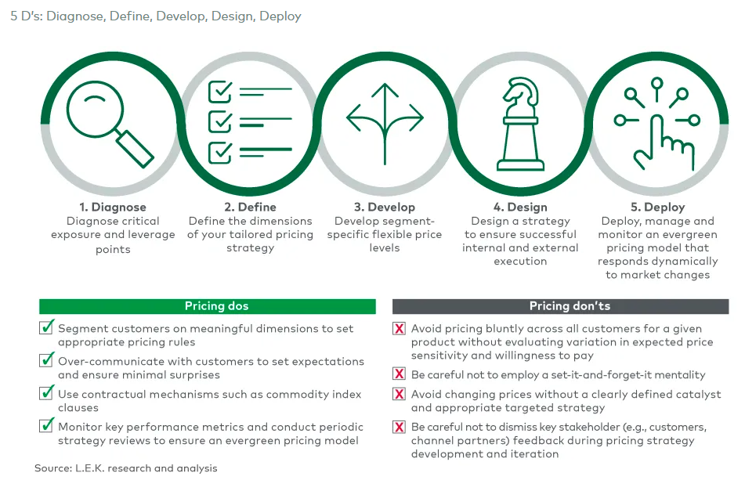
Pricing – Guiding principles
Listing or chart highlighting specific guiding principles – anything applicable
to your guiding principles.
5 Ds: DIAGNOSE, DEFINE, DEVELOP, DESIGN, DEPLOY¹
Examples/ideas to get you started:
Proposing new price increases to offset margin decreases due to inflation
Downstream implications to prior price increases
Revaluation of current pricing strategy, discussion points to avoid succumbing to the temptation to use price as a blunt instrument for short-term wins
Situational analysis and market trends
Opportunities and challenges
1

Slide 42
Current pricing
Approach: Include details about your pricing structure
and strategy.
STRUCTURE
Product / SKU | Description | Other key attribute | Market price (ASP) | Landed cost (TP0) | Margin | Margin %

Slide 43
Current pricing
Include details or charts for rebate structures, which can be listed out by GPO, tier, or however your rebate program is structured.
[REBATE AND/OUR REIMBURSEMENT STRUCTURE]
If applicable, include key details about reimbursement through varying payor types and at varying degrees of complexity.
Feel free to include landed or TP0 pricing and margin calculations as well. This can help to identify where you want the most customer acquisition.

Slide 44
Overall pricing goals and recommendations
Create a
list or chart highlighting specific pricing goals.
If proposing price changes / increases, lay out your varying scenarios and consider including the following:
Timeframe for implementation
Impact on GPO cycles
Percentage of customer loss
Impact on current agreements (if any)
Implications to varying market segments

Slide 45
I wish I knew (IWIK)

Slide 46
"I wish I knew" (IWIK)
Customize this
to what
you want to
know.
There are four components to the IWIK process:
ASK, BRAINSTORM, CAPTURE, AND DELIBERATE
This can be external items, internal factors you want to understand more about, and whether a budget request is required to gather information. These should be framed as output statements and act as a catalyst to bring clarity to an issue.
I wish I knew | How am I going to gather the information / Sources | Timing | Budget

Slide 47
Appendix

